Slide 1
Non-Deterministic Polynomial Algorithms
Module 4
AoA Even 2021-22

Slide 2
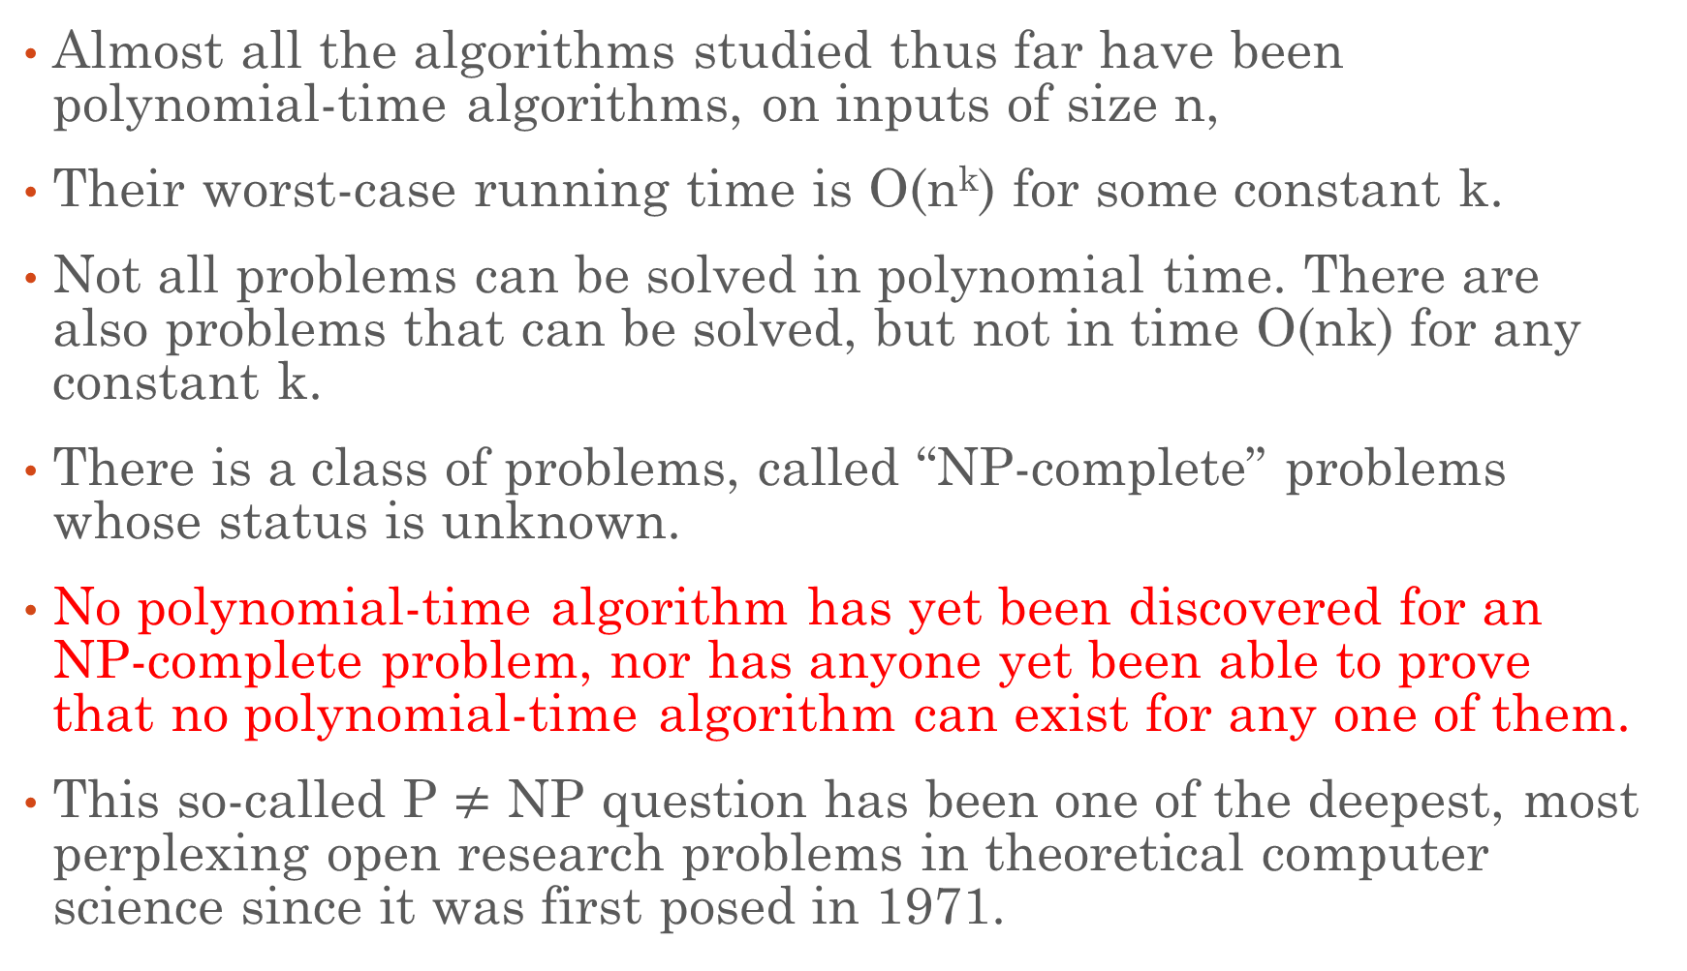
Introduction
Almost all the algorithms studied thus far have been polynomial-time algorithms, on inputs of size n,
Their worst-case running time is O(n^{k}) for some constant k.
Not all problems can be solved in polynomial time. There are also problems that can be solved, but not in time O(nk) for any constant k.
There is a class of problems, called “NP-complete” problems whose status is unknown.
No polynomial-time algorithm has yet been discovered for an NP-complete problem, nor has anyone yet been able to prove that no polynomial-time algorithm can exist for any one of them.
This so-called P $≠$ NP question has been one of the deepest, most perplexing open research problems in theoretical computer science since it was first posed in 1971.

Slide 3
Introduction
Introduction to P and NP Classes:
P, NP, NP-Hard and NP-Complete are classes that any problem would fall under or would be classified as.
P(Polynomial) problems:
P problems refer to problems where an algorithm would take a polynomial amount of time to solve.
If an algorithm is polynomial, we can formally define its time complexity as: T(n) = O(C * n^{k} ) where, C > 0 and k > 0 where C and k are constants and is input size.
In general, for polynomial-time algorithms k is expected to be less than n.
Many algorithms complete in polynomial time:
➢ Linear Search (n)
➢ Binary Search (logn)
➢ Insertion Sort (n² )
➢ Merge Sort (nlogn)
➢ Matrix Multiplication (n³)

Slide 4
Introduction to P and NP Classes
NP (Non-deterministic Polynomial) Problems:
NP class problems don’t have a polynomial run-time to solve but have a polynomial run-time to verify solutions.
These algorithms have an exponential complexity, which we’ll define as:
T(n) = O(C₁*k^{nC}₂) where C₁ > 0, C₂ > 0 and k > 0 where C₁, C₂, k are constants and n is the input size.
There are several algorithms that fit this description.
➢ 0/1 knapsack problem (2^{n} )
➢ Traveling salesperson problem
➢ Sum of Subsets problem
➢ Graph coloring problem
➢ Hamiltonian cycles problem

Slide 5
Introduction to P and NP Classes
NP (Non-deterministic Polynomial) Problems:
The problems that are solved in polynomial time are called tractable problems and the problems that require super polynomial time are called non-tractable problems.
All deterministic polynomial time algorithms are tractable and the non-deterministic polynomials are intractable.

Slide 6
Introduction to P and NP Classes
Non-deterministic Algorithms:
When the result of every operation is uniquely defined then it is called deterministic algorithm.
When the outcome is not uniquely defined but is limited to a specific set of possibilities, we call it non-deterministic algorithm.
New statements to specify such algorithms.
➢ choice(S): arbitrarily choose one of the elements of set S
➢ failure: signals an unsuccessful completion
➢ success: signals a successful completion
The assignment X:= choice(1:n) could result in X being assigned any value from the integer range[1..n]. There is no rule specifying how this value is chosen.
The nondeterministic algorithms terminates unsuccessfully if and only if there is no set of choices which leads to the successful signal.

Slide 7
Introduction to P and NP Classes
Non-deterministic Algorithms:
Example:
Searching an element x in a given set of elements A(1:n). We are required to determine an index j such that a(j) = x or j = 0 if x is not present.
Algorithm NSearch(A, n, key)
{
j = choice();
if(key = a[j]) then
{
write(j); Success();
}
write(0);
Failure();
}

Slide 8
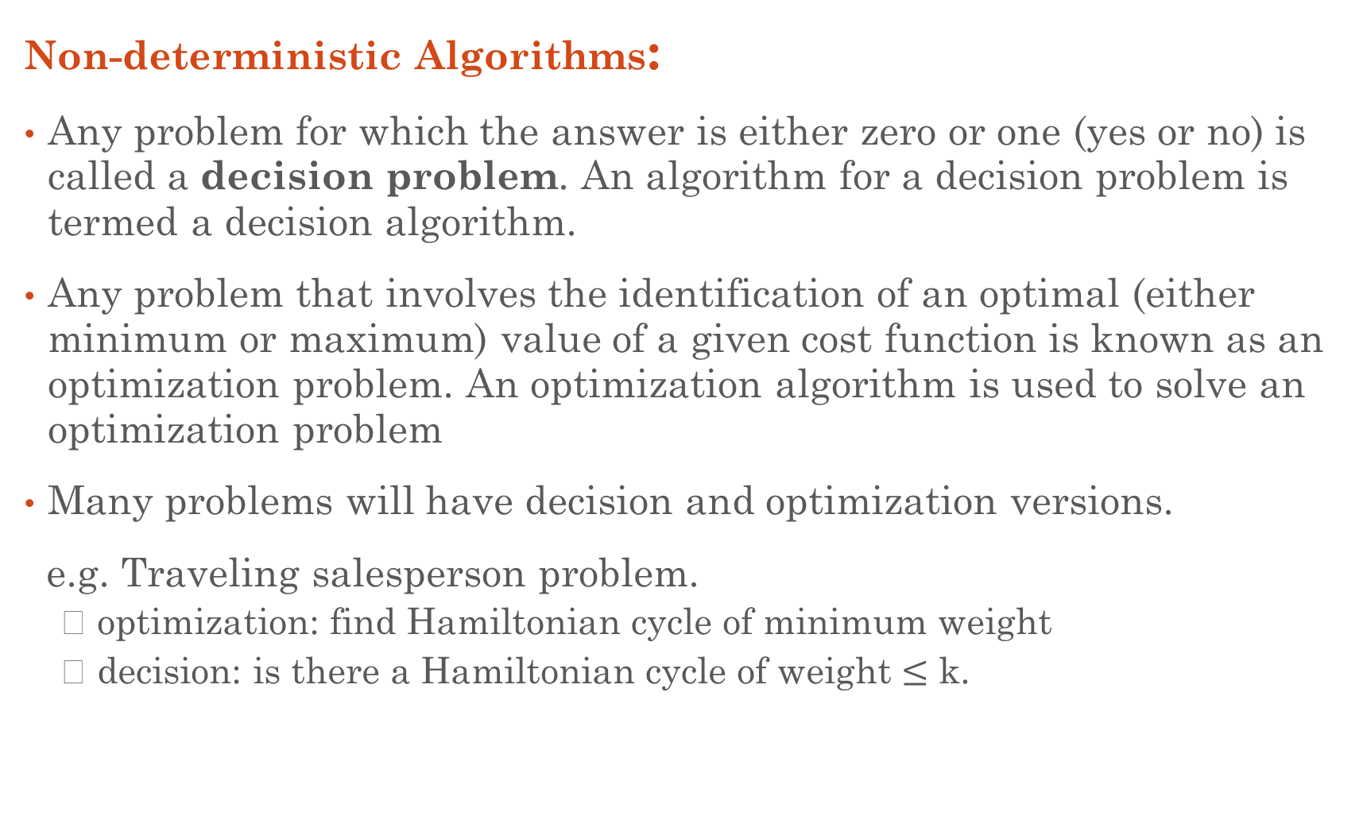
Introduction to P and NP Classes
Non-deterministic Algorithms:
Any problem for which the answer is either zero or one (yes or no) is called a decision problem. An algorithm for a decision problem is termed a decision algorithm.
Any problem that involves the identification of an optimal (either minimum or maximum) value of a given cost function is known as an optimization problem. An optimization algorithm is used to solve an optimization problem
Many problems will have decision and optimization versions.
e.g. Traveling salesperson problem.
➢ optimization: find Hamiltonian cycle of minimum weight
➢ decision: is there a Hamiltonian cycle of weight $≤$ k.

Slide 9
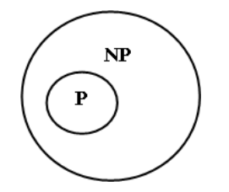
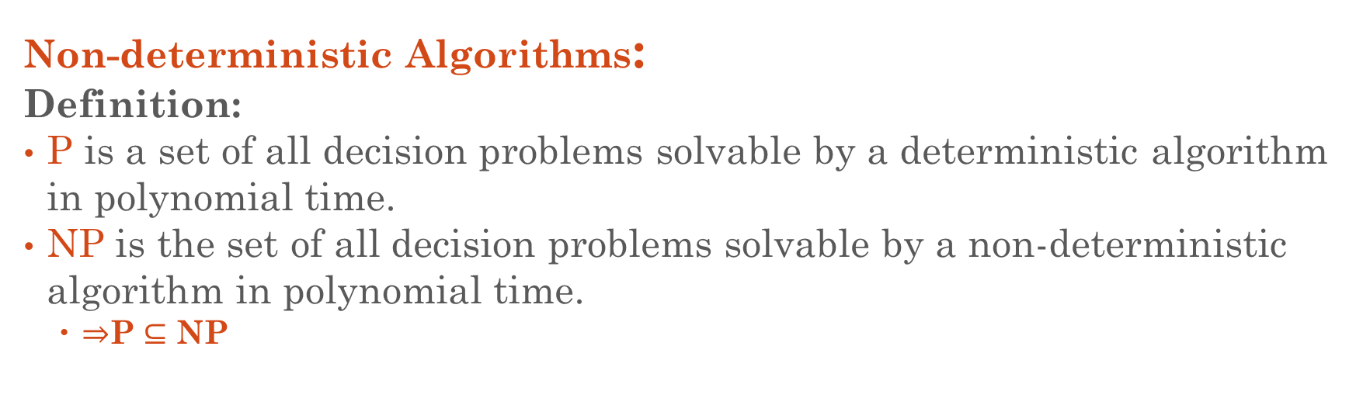
Introduction to P and NP Classes
Non-deterministic Algorithms:
Definition:
P is a set of all decision problems solvable by a deterministic algorithm in polynomial time.
NP is the set of all decision problems solvable by a non-deterministic algorithm in polynomial time.
$⇒$P $⊆$ NP
Let L1 and L2 be problems. L1 reduces to L2 (L1∝ L2 ) if and only if there is a way to solve L1 by deterministic polynomial time algorithm that solve L2 in polynomial time.

Slide 10
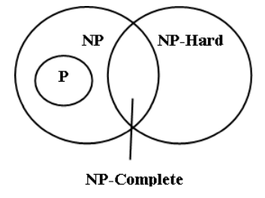
Introduction to NP-Hard and NP-Complete
Non-deterministic Algorithms:
A problem is NP-Hard if all problems in NP are polynomial time reducible to it.
A problem is NP-complete if the problem is both
– NP-hard, and
– NP
All NP-Complete problems are NP-Hard, but not all NP-Hard problems are NP-Complete.
NP-Complete problems are subclass of NP-Hard.

Slide 11
Introduction to NP-Hard and NP-Complete
Non-deterministic Algorithms:
NP-Hard: A problem L is NP-Hard iff satisfiability reduces to L i.e., any nondeterministic polynomial time problem is satisfiable and reducible then the problem is said to be NP-Hard.
Example: Halting Problem, Flow shop scheduling problem.
NP-Complete: A problem L is NP-Complete iff L is NP-Hard and L belongs to NP (nondeterministic polynomial).
A problem that is NP-Complete has the property that it can be solved in polynomial time iff all other NP-Complete problems can also be solved in polynomial time. (NP=P).
If an NP-hard problem can be solved in polynomial time, then all NP- complete problems can be solved in polynomial time.
All NP-Complete problems are NP-hard, but some NP-hard problems are not known to be NP- Complete.
Normally the decision problems are NP-complete but the optimization problems are NP-Hard.
Example: Knapsack decision problem can be reduced to knapsack optimization problem. There are some NP-hard problems that are not NP-Complete.

Slide 12
Introduction to NP-Hard and NP-Complete
Reducibility:
The class NP-complete (NPC) problems consist of a set of decision problems (a subset of class NP) that no one knows how to solve efficiently. But if there were a polynomial solution for even a single NP-complete problem, then every problem in NPC will be solvable in polynomial time. For this, we need the concept of reductions.
A problem Q1 can be reduced to Q2 if any instance of Q1 can be easily rephrased as an instance of Q2. If the solution to the problem Q2 provides a solution to the problem Q1, then these are said to be reducible problems.

Slide 13
Introduction to NP-Hard and NP-Complete
Criteria to come either in NP-hard or NP-complete:
The output is already given, and you can verify the output/solution within the polynomial time but can't produce an output/solution in polynomial time.
Here we need the concept of reduction because when you can't produce an output of the problem according to the given input then in case you have to use an emphasis on the concept of reduction in which you can convert one problem into another problem.
If you satisfy both points then your problem comes into the category of NP-complete class.
If you satisfy the only 2nd points then your problem comes into the category of NP-hard class
.

Slide 14
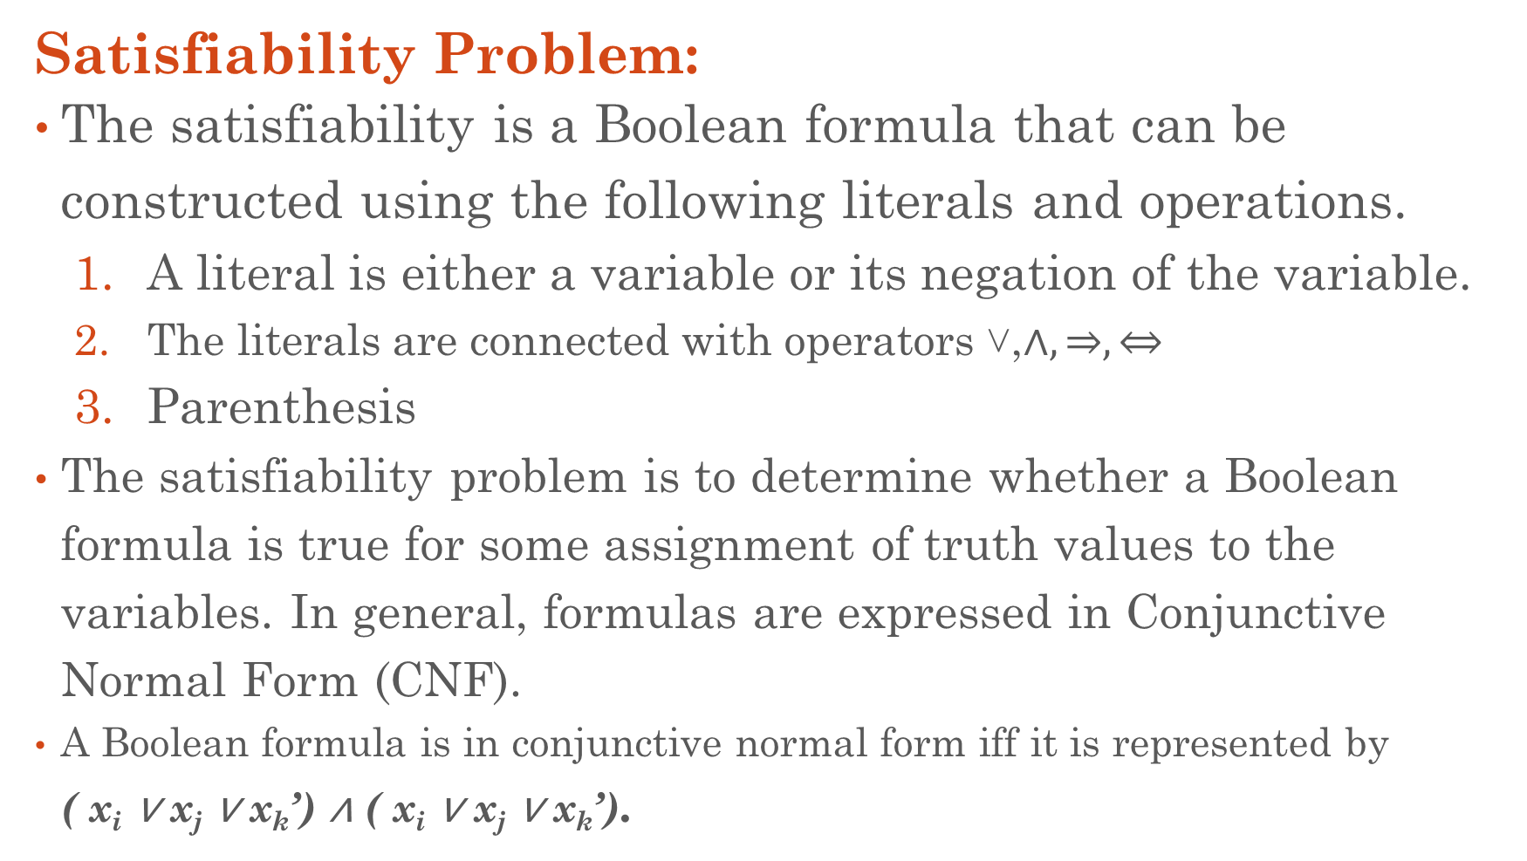
Introduction to NP-Hard and NP-Complete
Satisfiability Problem:
The satisfiability is a Boolean formula that can be constructed using the following literals and operations.
A literal is either a variable or its negation of the variable.
The literals are connected with operators ˅,$∧,⇒,⇔$
Parenthesis
The satisfiability problem is to determine whether a Boolean formula is true for some assignment of truth values to the variables. In general, formulas are expressed in Conjunctive Normal Form (CNF).
A Boolean formula is in conjunctive normal form iff it is represented by ( x_{i} ∨ x_{j} ∨ x_{k}’) ∧ ( x_{i} ∨ x_{j} ∨ x_{k}’).

Slide 15
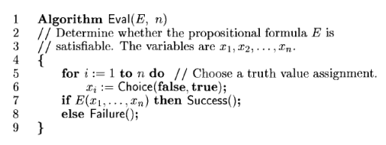
Introduction to NP-Hard and NP-Complete
Satisfiability Problem:
Nondeterministic Satisfiability

Slide 16
Introduction to NP-Complete
The Clique Problem:
NP-complete problems arise in diverse domains: Boolean logic, graphs, arithmetic, network design, sets and partitions, storage and retrieval, sequencing and scheduling, mathematical programming, algebra and number theory, games and puzzles, automata and language theory, program optimization, biology, chemistry, physics, and more.
A clique is a subset of vertices of an undirected graph G such that every two distinct vertices in the clique are adjacent; that is, its induced subgraph is complete.
The task of finding whether there is a clique of a given size in a graph (the clique problem) is NP-complete.

Slide 17
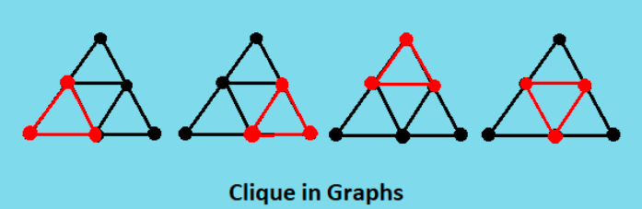
Introduction to NP-Complete
The Clique Problem:
A maximal clique is a clique that cannot be extended by including one more adjacent vertex, that is, a clique which does not exist exclusively within the vertex set of a larger clique.
A maximum clique of a graph, G, is a clique, such that there is no clique with more vertices. Moreover, the clique number ω(G) of a graph G is the number of vertices in a maximum clique in G.

Slide 18
Introduction to NP-Complete
What is the Clique Problem?
The clique problem is the computational problem of finding cliques in a graph.
It has several different formulations depending on which cliques, and what information about the cliques, should be found.
Common formulations of the clique problem include finding a maximum clique, finding a maximum weight clique in a weighted graph, listing all maximal cliques, and solving the decision problem of testing whether a graph contains a clique larger than a given size.
Most versions of the clique problem are hard. The clique decision problem is NP-complete.
The problem of finding the maximum clique is both fixed-parameter intractable and hard to approximate. And listing all maximal cliques may require exponential time as there exist graphs with exponentially many maximal cliques.

Slide 19
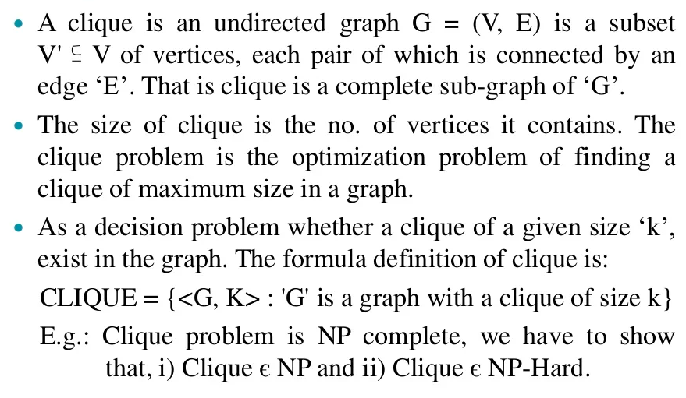
Introduction to NP-Complete

Slide 20
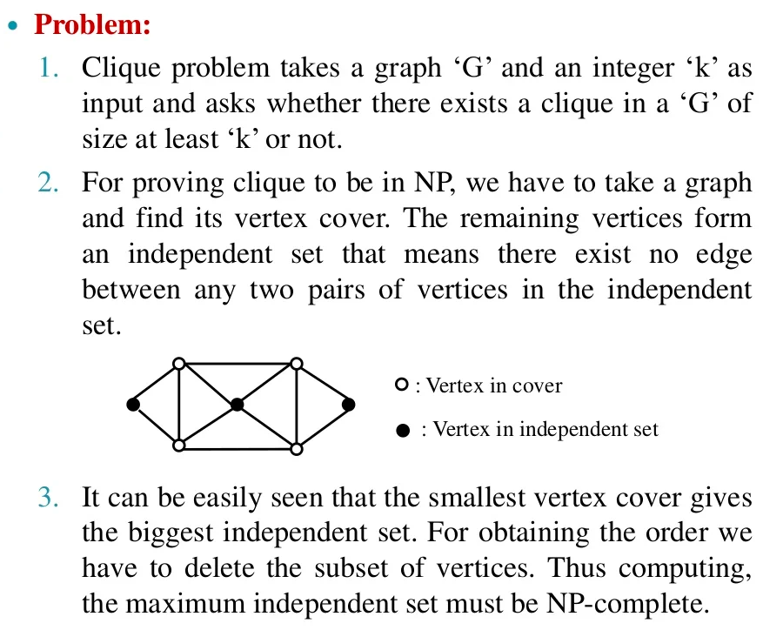
Introduction to NP-Complete

Slide 21
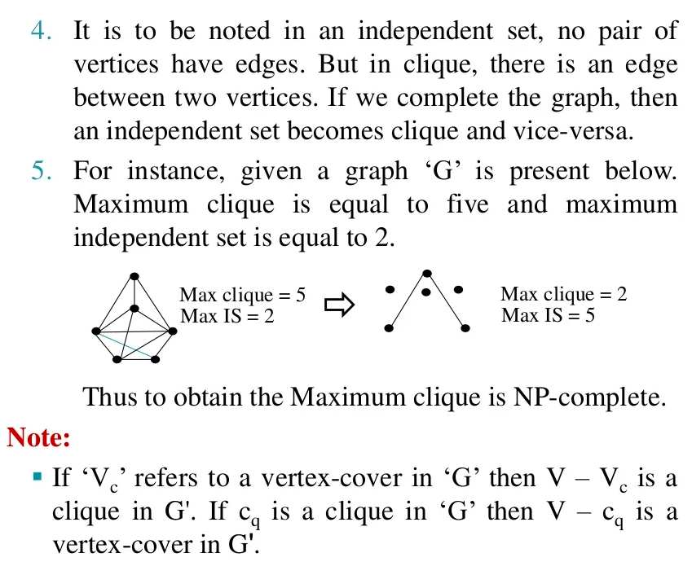
Introduction to NP-Complete

Slide 22
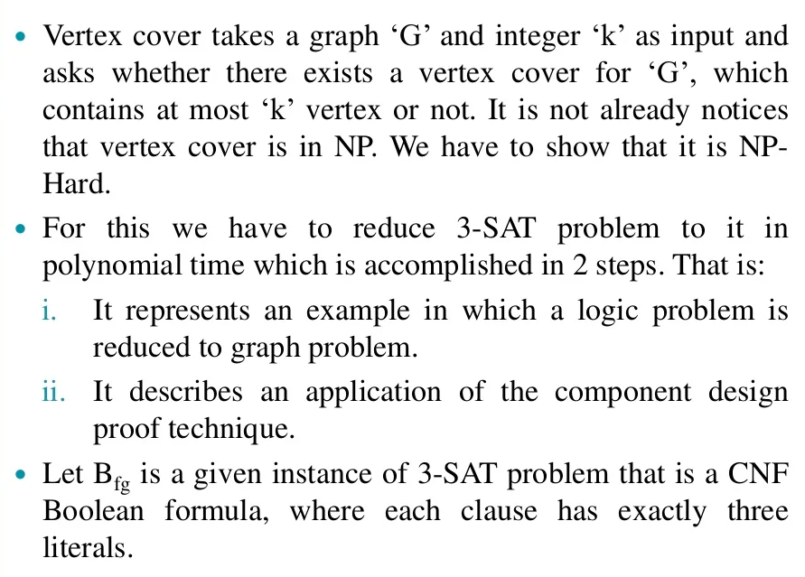
Introduction to NP-Complete
The Vertex Cover Problem:

Slide 23
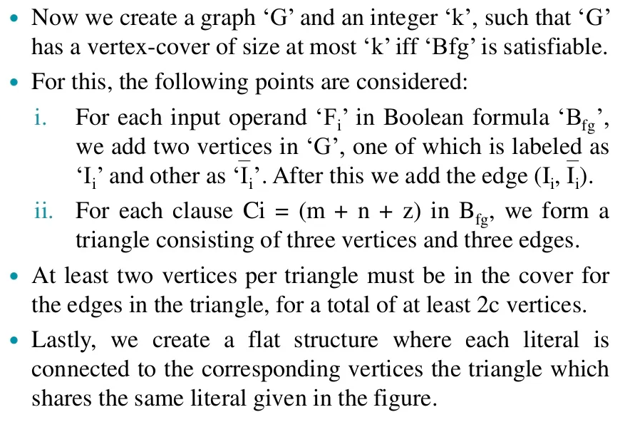
Introduction to NP-Complete
The Vertex Cover Problem:

Slide 24
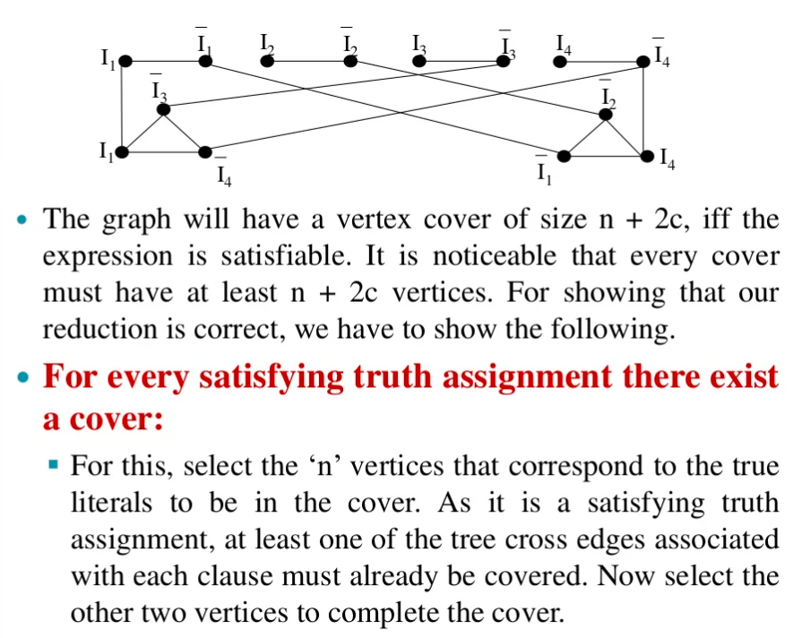
Introduction to NP-Complete
The Vertex Cover Problem:

Slide 25
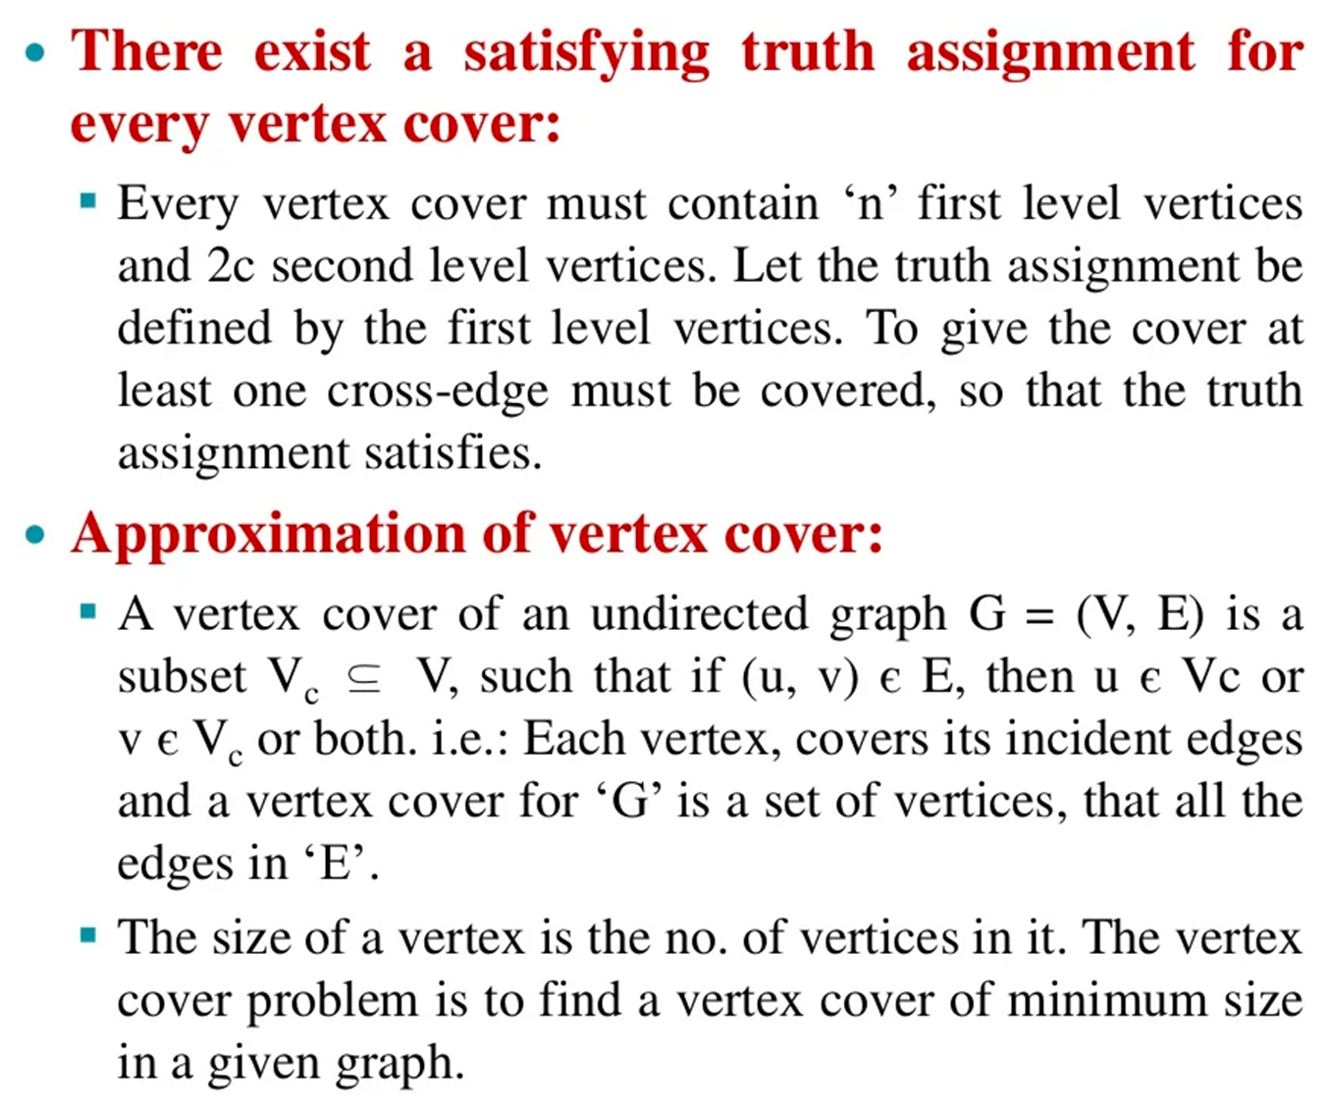
Introduction to NP-Complete
The Vertex Cover Problem:

Slide 26
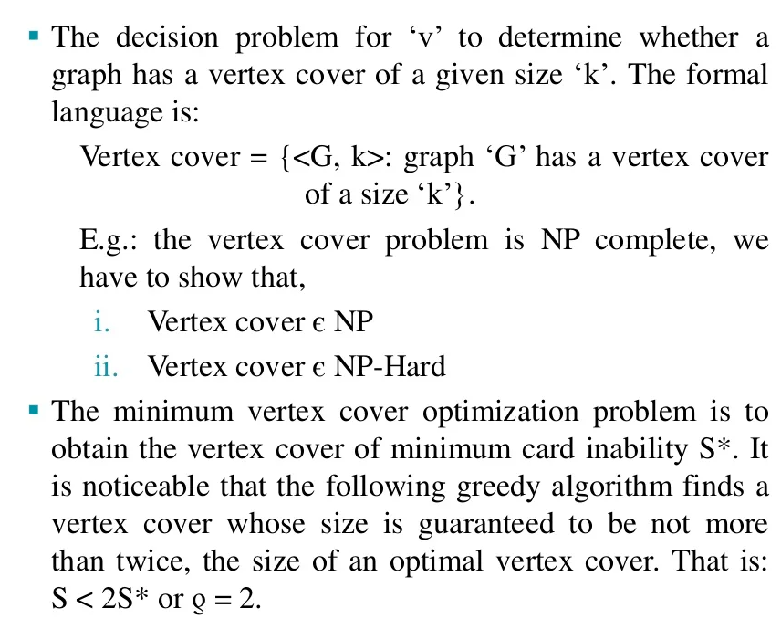
Introduction to NP-Complete
The Vertex Cover Problem:

Slide 27
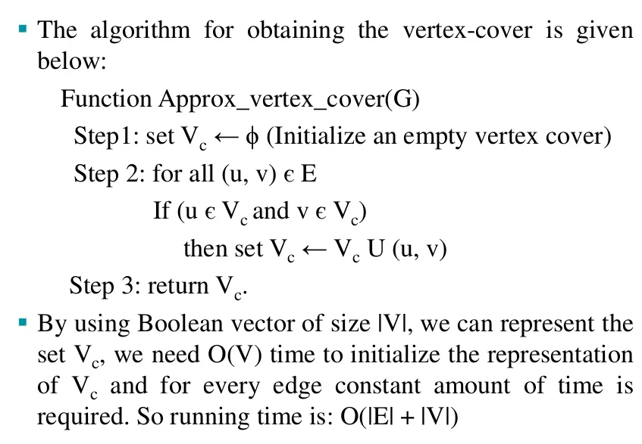
Introduction to NP-Complete
The Vertex Cover Problem:

